Slide 1
Software Development Life Cycle
Where coding turns into development

Slide 2
Table of Contents
01
02
03
04
SDLC
The software development lifecycle.
Methodologies
Principles, tools, and practices of development.
Frameworks
Specific implementations of a methodology.

Slide 3
SDLC
The Software Development Life Cycle is the general process followed by software development. There are different methodologies to achieve this, including Waterfall and Agile.

Slide 4
1) Gather Requirements
8) Maintain
2) Analysis
SDLC
3) Design
7) Release
6) User Acceptance Testing
4) Development
5) Testing

Slide 5
SDLC Methodologies
Big Bang
Waterfall
01
02
Where most developers begin.
The classic method.
Agile
03
The modern method.

Slide 6
01
Big Bang
The Explosive Methodology

Slide 7
02
Waterfall
The Classic Methodology

Slide 8
Gather Requirements
Analysis
Design
Development
Testing
User Acceptance Testing
Deploy

Slide 9
Waterfall
Pros
Cons
Waterfall features clear, well defined steps.
Waterfall is intuitive and doesn't require specialized knowledge.
Waterfall has a clear and concrete end goal early on.
Waterfall allows for clean transfer of information from step to step.
Waterfall makes changes difficult as it always moves forward.
Waterfall excludes the client beyond the initial gather requirements phase.
Waterfall delays testing until completion, leaving potential problems unnoticed until the latter half of a project.

Slide 10
03
Agile
The Modern Methodology

Slide 11
Deploy
Design
Iteration
Design
Deploy
2-3 Months
Develop
Iteration
Design
Deploy
2-3 Months
Develop
Iteration
Develop

Slide 12
Agile
Pros
Cons
Agile allows for a team to quickly respond to change.
Agile allows for uncertainty at the beginning.
Agile has faster review cycles compared to Waterfall.
Agile has greater flexibility in releases.
Agile's increased flexibility can lead to bad behaviours.
Agile requires more knowledge to use properly.
Agile has a lack of predictability.

Slide 13
Agile Frameworks
Scrum
Kanban
eXtreme Programming

Slide 14
Scrum
Agile Framework

Slide 15
Design
Deploy
Sprint
Design
Deploy
2-4 Weeks
Develop
Sprint
Design
Deploy
2-4 Weeks
Develop
Sprint
Develop

Slide 16
Daily
Standup
Product Backlog
Sprint
Sprint Backlog
Backlog Refinement
Sprint Planning
Review
Retrospective

Slide 17
Commitment
Team members personally commit to achieving team goals
Courage
Team members do the right thing and work on tough problems.
Focus
Concentrate on the work identified for the sprint and the goals of the team.
Openness
Team members and stakeholders are open about all the work and the challenges the team encounters.
Respect
Team members respect each other to be capable and independent.
Values
Teams following scrum are expected to learn and explore the following values

Slide 18
The team must work in an environment where everyone is aware of what issues other team members are running into. Teams surface issues within the organization, often ones that have been there for a long time, that get in the way of the team’s success.
Frequent inspection points built into the framework to allow the team an opportunity to reflect on how the process is working. These inspection points include the Daily Scrum meeting and the Sprint Review Meeting.
The team constantly investigates how things are going and revises those items that do not seem to make sense.
Transparency
Principles
The following principles underpin the empirical nature of scrum
Inspection
Adaptation

Slide 19
Roles
Product Owner
Manages the Backlog
Scrum Master
Ensures ceremonies are followed
Development Team
Delivers the product

Slide 20
Scrum
Pros
Cons
Scrum makes it easier to find and rectify mistakes.
Scrum enforces daily standups which allows you to identify problems quickly.
Scrum allows for constant feedback with short sprints, letting you to adapt to changing client needs and input.
Scrum involves clients throughout, leading to more desired and accurate outcomes.
Scrum lacks firm final deadlines which can result in feature creep.
Scrum requires a strong commitment from the team members, and has added pressure on each member.
Scrum lacks a firm time limit and cost valuations, which can cause uncertainty.

Slide 21
Kanban
Agile Framework

Slide 22
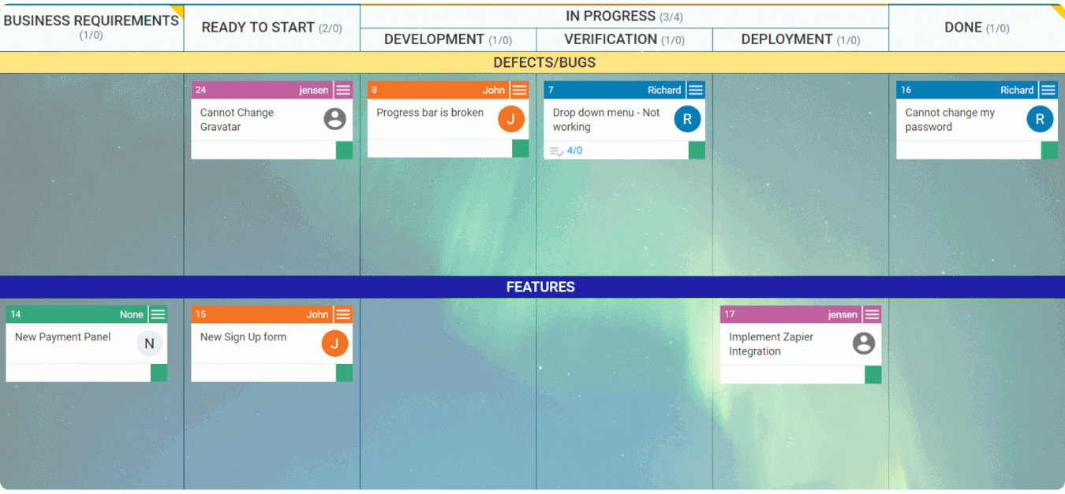

Slide 23
Kanban
Pros
Cons
Kanban is event-driven instead of timeboxed.
Kanban board can be added to whenever there is capacity.
Kanban allows for specialists, whereas cross-functional teams are optional.
Kanban board is persistent.
Kanban boards are easy to become overcomplicated.
Kanban boards if allowed to become outdated cause issues in development.
Kanban lacks a timing element, causing potential issues with project timelines.

Slide 24
Scrumban
Agile Framework

Slide 25
eXtreme Programming
Agile Framework

Slide 26

User Epics
Identify unique sets of user stories, and combine them into epics.
If multiple user stories/use cases relate to a ‘Manager’ user, then they should be collected into the manager epic.

Slide 27

Paired Programming
Paired programming is the process of two developers working on a specific piece of code or feature together.
Pilot
The pilot is focused on the immediate needs of the code and is the one who writes it.
Navigator
The navigator should be focused on the bigger picture and how it will fit in the greater project.

Slide 28
Story Points & Velocity
Agile Toolset

Slide 29

Story Points & Hours
Story points are used to help give us an estimate, determine difficulty, and prioritization of our use cases.
Different groups might use different methods, the important part is that the group collaborates and everyone understands the method used.

Slide 30

Velocity
Velocity is used hand in hand with story points. Velocity is the number of story points completed in a sprint. By understanding our velocity we can make better long term planning for our project.

Slide 31
eXtreme Programming
Pros
XP is fast, it is a very fast paced environment with CI/CD.
XP is open, communication and work environment is geared towards helping make everyone aware and making progress.
XP reduces costs, with a incredibly small feedback loop and rapid ability to change it keeps things in line with customer expectations.
XP teamwork plays a large role, especially with paired programming coming into use. Which tends to increase employee commitment and satisfaction.

Slide 32
eXtreme Programming
Cons
XP is code over design, incremental design focuses on just getting the code working in the simplest way first rather than focusing on the design aspect.
XP can be difficult to implement, it is highly specific, and requires the client to be embedded in the team. Both of those can be tough hurdles.
XP has poor documentation. Because of the rapid changes it is exceedingly difficult to keep things documented, and that documentation up to date.
XP is stressful, there are tight deadlines and it is very fast paced, which can make things difficult.

Slide 33
Vocabulary
Let’s review our terminology.
SDLC The software development life cycle is a general overview of the process of software development.
Methodology The overall strategies for software development. Big Bang, Waterfall, and Agile.
Framework Specific implementations of methodologies. Such as Scrum, Kanban, and XP.
Velocity The rate at which your team is able to complete tasks.

Slide 34
What to Expect
Scrum
What are the different ceremonies in Scrum?
SDLC
Velocity
What is the SDLC, and what are the phases in it?
How do you determine your velocity?

Slide 35
Thanks!
Do you have any questions?
Please keep this slide for attribution

Slide 36
Assessment Prompts
Agile
What are some pros and cons of Agile?
Scrum
Kanban
What are the Scrum ceremonies?
Explain the purpose and use of the Kanban Board

